Slide 1

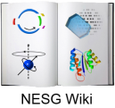


NESG Wiki: NMR Data Acquisition
Alexander Eletsky 01/10/2010

Slide 2
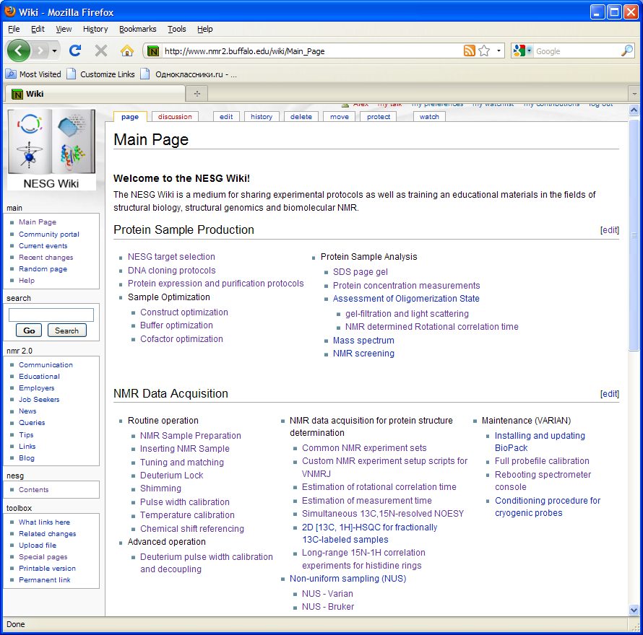
Introduction
Documenting NESG protocols: reference and educational information
Specific details for Varian and Bruker instruments
Some expertise in NMR expected from users

Slide 3
Spectromer Operation

Slide 4
NMR Experiments for Structure Determination
Standard experiment sets for high-throughput NMR
Additional experiments and novel methods

Slide 5
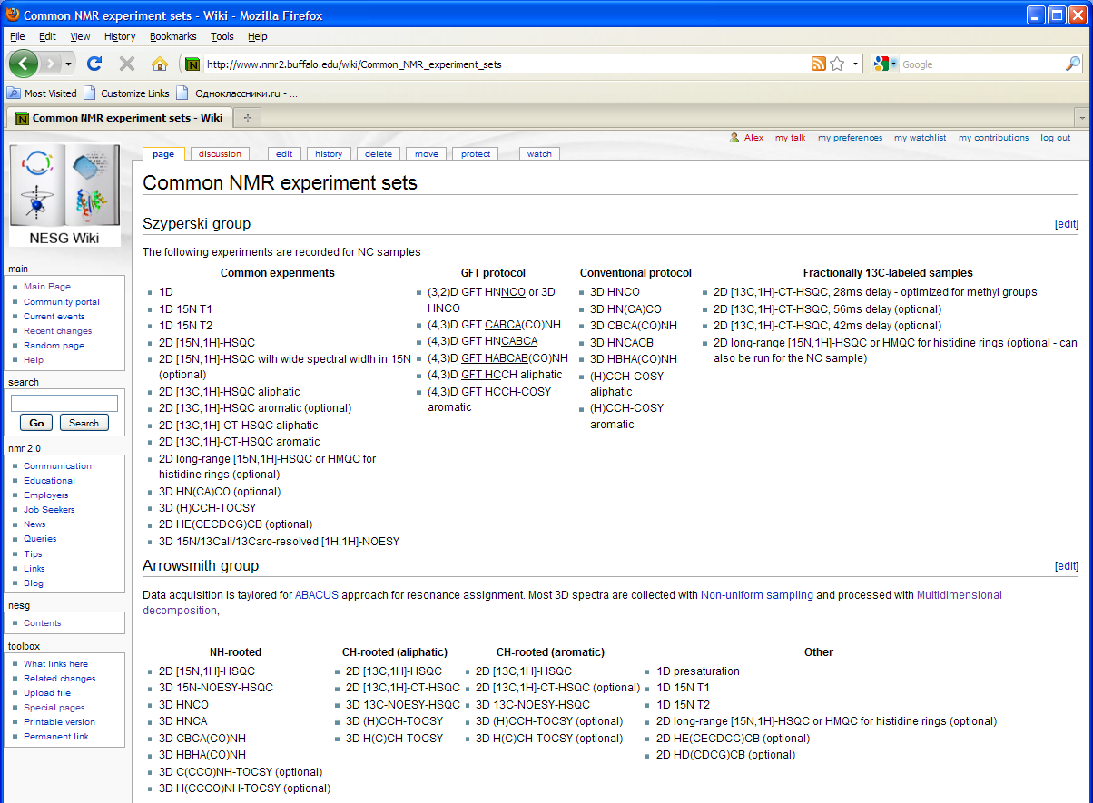
“Standard” NMR Experiments

Slide 6
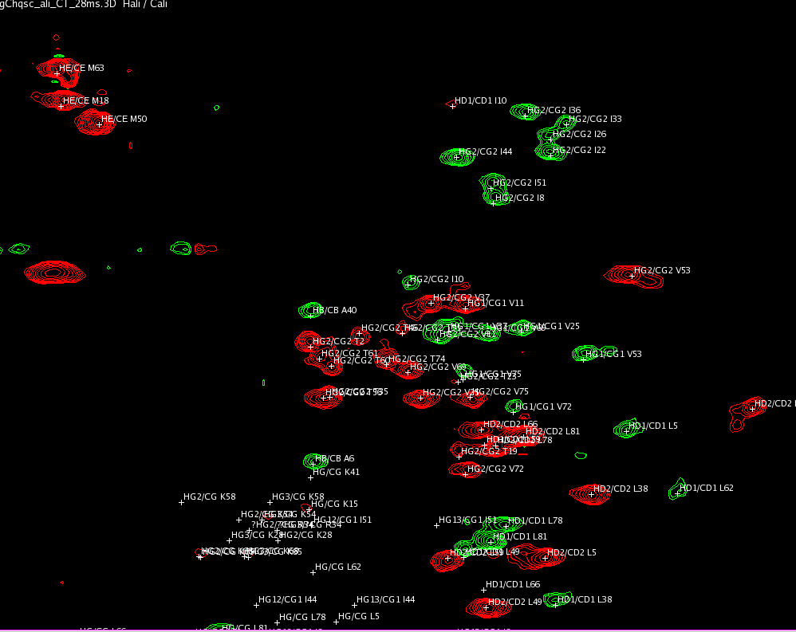
Stereospecific Assignment of Leu/Val Isopropyl Groups
D. Neri, T. Szyperski, G. Otting, H. Senn, K. Wuethrich, Biochemistry 1989; 28(19):7510-7516
Optimized CT [¹³C,¹H]-HSQC (28ms, 42ms and 56ms) for fractionally ¹³C-labeled samples

Slide 7
Histidine Protonation State
Long-range [¹⁵N,¹H]-HSQC or HMQC
Also yields H^{ε1}/N^{ε1} spin assignments
J. G. Pelton, D. A. Torchia, N. D. Meadow, and S. Roseman, Protein Sci. 1993; 2(4): 543–558.

Slide 8
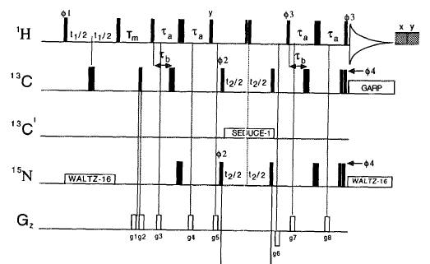
3D ¹³C/¹⁵N-resolved NOESY
Optimized for simultaneous ¹³C(aliphatic), ¹³C(aromatic) and ¹⁵N frequency labeling
Uses adiabatic ¹³C decoupling sideband suppression (SEAD – E. Kupce)
Spectra acquired at 900 MHz
Three-fold time saving compared to separate experiments
S. M. Pascal, D. R. Muhandiram, T. Yamazaki, J. D. Forman-Kay, and L. E. Kay, JMR Ser. B. 1994; 103:197–201. Y. Shen, H. S. Atreya, G. Liu, and T. Szyperski, JACS 2005; 127:9085-9099.

Slide 9
Acknowledgements
James M. Aramini
Aleksandras Gutmanas
Gaohua Liu
Jeffrey L. Mills
Theresa A. Ramelot
Paolo Rossi
Kiran K. Singarapu
Yibing Wu
Duanxiang Xu
Qi Zhang

